Slide 1

Solar Energy
Submitted To: -
Dr. Medhavi Jain
Presented By: -
Puneet Saluja (2015KUCP1019)
Jarnail Singh (2015KUCP1035)
Rakshit Agarwal (2015KUCP1037)
Sunil Yadav (2015KUCP1042)

Slide 2
CONTENTS
Introduction
Need of Solar Energy
Applications
National Solar Mission
International Solar Alliance
Advantages and Disadvantages

Slide 3
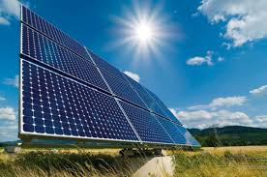
SOLAR ENERGY
Radiant light and heat from the sun that is used and transformed into different types of energy.
Most abundant source of renewable energy.

Slide 4
WHY TO PREFER SOLAR ENERGY ?
The fossil fuels are non-renewable sources so, we cannot depend on them forever.
Non-Polluting.
Silent source of electricity.
Needs low maintenance.

Slide 5
PRODUCING ELECTRICITY
Solar Energy can be used to generate electricity in 2 ways :
Thermal Solar Energy :
Using thermal energy for heating fluids which can be used to run turbines to get electricity.
Photovoltaic Solar Energy :
Photovoltaic technology directly converts sunlight into electricity.

Slide 6

APPLICATIONS
Solar water heating
Solar cooking
Solar electric power generation
Solar green houses
Solar-distillation
Solar Vehicles

Slide 7
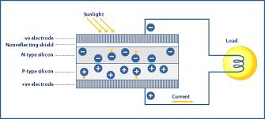
PHOTOVOLTAIC ELECTRICITY
Photovoltaic comes from word photo, meaning light.
Photovoltaic Electricity is obtained using photovoltaic system.
Photovoltaic system consists of four components :-
Solar Panel
Battery
Regulator
Load

Slide 8

SOLAR ENERGY IN AGRICULTURE
Apart from growing crops solar energy is used in pumping water and drying crops.
Reduce dependency of farmer on electric grid.
Cost per crop is reduced.
GREENHOUSES:Converts solar light to heat which allows year round production of crops requiring special environment conditions.

Slide 9
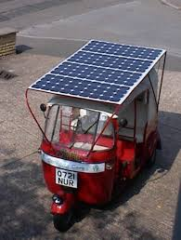
SOLAR VEHICLE
It is an electric vehicle powered completely or significantly by direct solar energy.
Auxiliary power: Solar Panels used in passenger cars in order to ventilate the car.

Slide 10
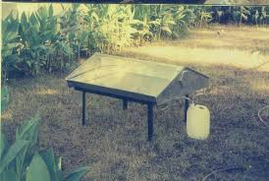
SOLAR ENERGY IN WATER TREATMENT
Solar distillation and SODIS can be used to make saline water potable.
Solar energy may be used in a water stabilisation pond to treat waste water without chemicals or electricity.

Slide 11
MEDICAL USE OF SOLAR ENERGY
These include, disinfection and sterilization without the use of chemicals.
Solar cells are placed under the skin to continuously recharge implanted electronic medical devices.
Solar Powered Portable Medical Kit.
Notes:
Pacemaker wala eg bolna

Slide 12
POTENTIAL OF SOLAR ENERGY
India has about 300 sunny days a year.
The Kamuthi Solar Power Project is in Tamil Nadu and is the highest solar power capacity in a single location: 648 MW.
Rajasthan, with its healthy resource of solar radiation and availability of vast tracts of wasteland in the form of the Thar Desert, has a potential of about 142 GW.
It was reported that 1,784 MW was the capacity of photovoltaic in Rajasthan.

Slide 13
NATIONAL SOLAR MISSION
Part of the National Action Plan on Climate Change.
Aims to promote the development and use of solar energy.
The objective is to reduce the cost of solar power generation.
Initial target was 20 GW by 2022 which was later increased to 100 GW by the Narendra Modi Government.

Slide 14
INTERNATIONAL SOLAR ALLIANCE
The initiative was launched at the UN Climate Change Conference in Paris at the end of 2015 by the President of France and the Prime Minister of India.
Promote solar technologies, and investment in the solar sector.
Formulate projects and programmes to promote solar applications.
India to produce 100 GW of solar energy by 2022.

Slide 15
ADVANTAGES
Pollution free.
Renewable.
Safer than traditional electric current.
Return on investment.
Silent and non polluting.
Solar cells can be added when there is demand for more energy.
Solar power causes less electricity loss.
Solar power is a free source of energy.

Slide 16
DISADVANTAGES
High initial cost.
Takes a lot of solar panels to be efficient initially.
Can only generate during the day.
Lower production in the winter months.
Depending on geographical location the size of the solar panels vary for the same power generation.
Associated with pollution.
Solar energy storage is expensive.

Slide 17
A Clean Energy’s Dirty Little Secret
Toxic waste from used solar panels poses a new global environmental threat.
Solar Panels create 300 times more toxic waste per unit of energy than nuclear power plants.
Discarded solar panels, which contain dangerous elements such as lead, chromium, and cadmium, are piling up around the world.
The resulting smoke from burning plastic contains toxic fumes that are carcinogenic.

Slide 18
References
http://indianpowersector.com
http://www.renewableenergyworld.com
http://www.intermtnwindandsolar.com
https://www.civicsolar.com/support/installer/articles/types-solar-energy

Slide 19
Thank You

